Slide 1


Multimedia Systems Lab, FAU
INTELLIGENT AND COLLABORATIVE AUTONOMOUS ROBOTS FOR REAL-TIME APPLICATIONS

Slide 2

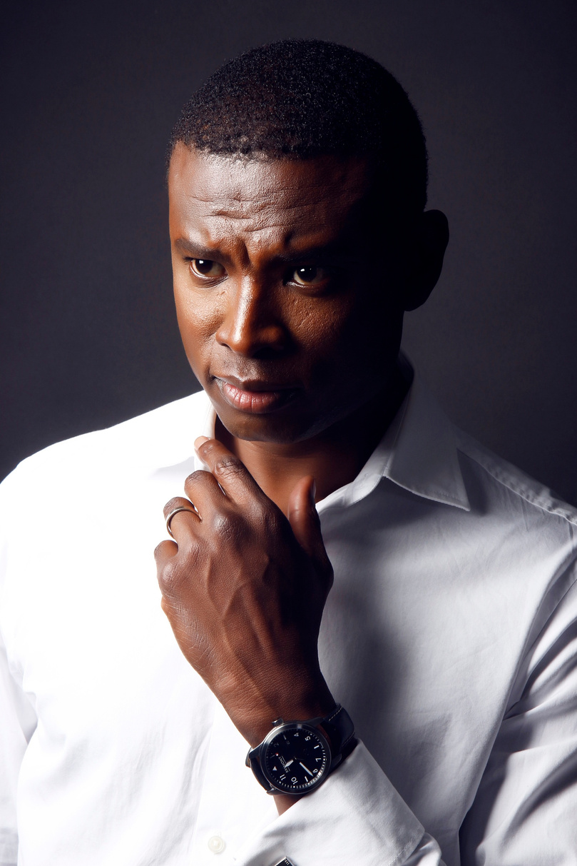
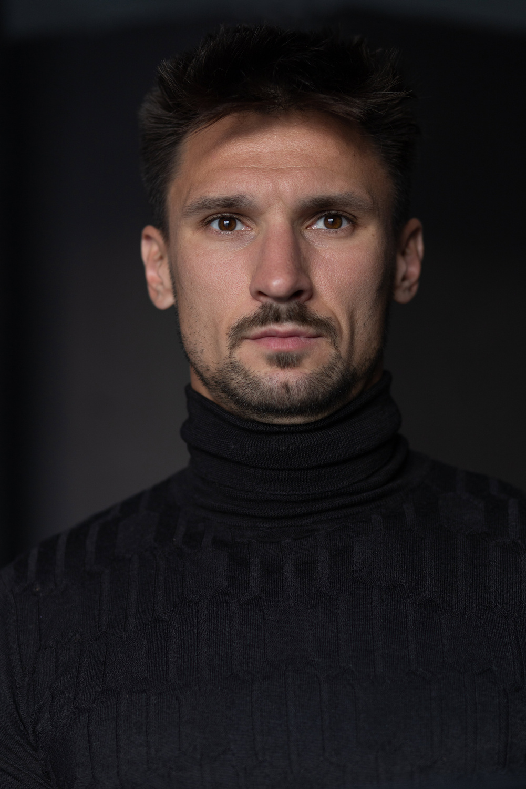

MEET THE TEAM
Thank you for your time! Reach out to us for questions.
IAN
SIMMONS
DAVID
UZAN
JOHN
SINFUEGO
Chief Executive Officer
Chief Executive Officer
Chief Executive Officer

Slide 3


TODAY'S AGENDA
1
Introduction
6
Project Testing
2
Project Goals
7
Discussion
3
Project Requirements/Constraints
8
Conclusion
4
Project Design
9
Project Demonstration
5
Project Implementation
10
Size of Market

Slide 4
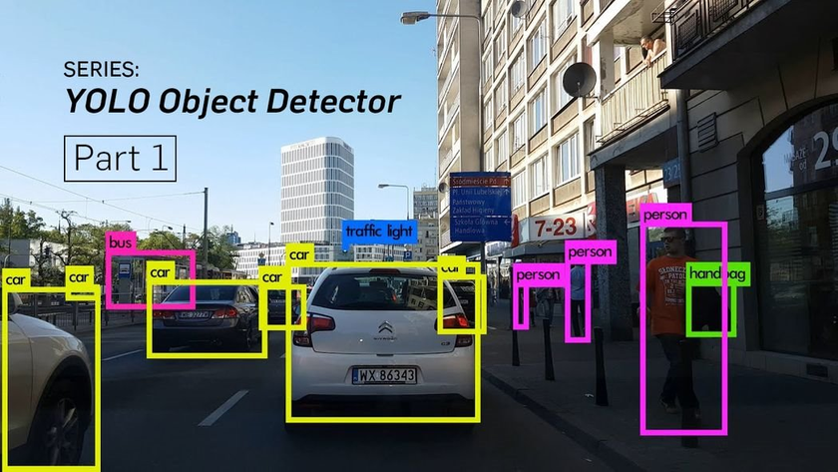
INTRODUCTION
Our project revolves around the Unitiree-Go1, which is an autonomous robot that has 5 cameras, seamless movement, and a built-in 16 core top CPU and GPU.
We will be integrating object detection technology using the Uni-Go1 by applying YOLOv8 libraries from Ultralytics.
These computations will be run on a Nvidia Jetson Orin Nano Developer Kit that will be plugged into the robot.
Utilizing our code, the robot will be able to navigate different environments and perform a wide range of field-tasks based on the detected object's confidence level calculated in the model.

Slide 5
PROJECT GOALS
Basic Plan
Standard Plan
Premium Plan
Technical | Integrate Yolo | 175$/ month | 220$/ month
Operational | Limited features Basic support No customization | More features Standard support Some customization | Full features Priority support Full customization
Evaluation | Limited usage Limited storage | Increased usage More storage | Unlimited usage Unlimited storage
Additional Services | No additional services included | Optional add-ons available for purchase | Premium support and consulting included

Slide 6

PROJECT REQUIREMENTS/CONSTRAINTS
2021
2023
2025
Present
In our first year, we successfully launched a new product/service, received positive feedback from early users, and formed partnerships with key industry players.
We expanded into new markets, improved operational efficiency, and saw an increase in customer satisfaction.
We secured funding for growth, refined our offerings based on customer feedback, and formed strategic partnerships.
We achieved profitability, expanded our product line, and strengthened our brand reputation through positive customer feedback.

Slide 7




PROJECT DESIGN
Find Unique Selling Point
Brand Messaging Guidelines
Agile Marketing Approach
Help startups figure out what makes them special and build their brand around it. This involves learning about their competitors and target audience, then creating a clear message that sets them apart.
Make sure all of the startup's marketing materials send the same message. This means having clear guidelines for how they talk about themselves and making sure everyone sticks to them.
Help startups adapt quickly to changes in the market. This means keeping an eye on what's happening, analyzing data, and being willing to try new things to keep their marketing strategy fresh and effective.

Slide 8
Lack of Brand Differentiation
Startups often find it hard to make their brand unique in a crowded market. Without a clear way to stand out, they struggle to catch the eye of potential customers and lose out to bigger competitors.
Inconsistent Brand Messaging
inconsistency in brand messaging across various marketing channels confuses potential customers and dilutes brand perception. Startups often face challenges in maintaining a cohesive message that effectively communicates their value proposition and resonates with their target audience.
PROJECT IMPLEMENTATION
Keeping Up with Trends
The market changes fast, and startups need to keep up. But without a big team or resources, it's tough to stay on top of the latest trends and adapt their marketing strategies accordingly.

Slide 9
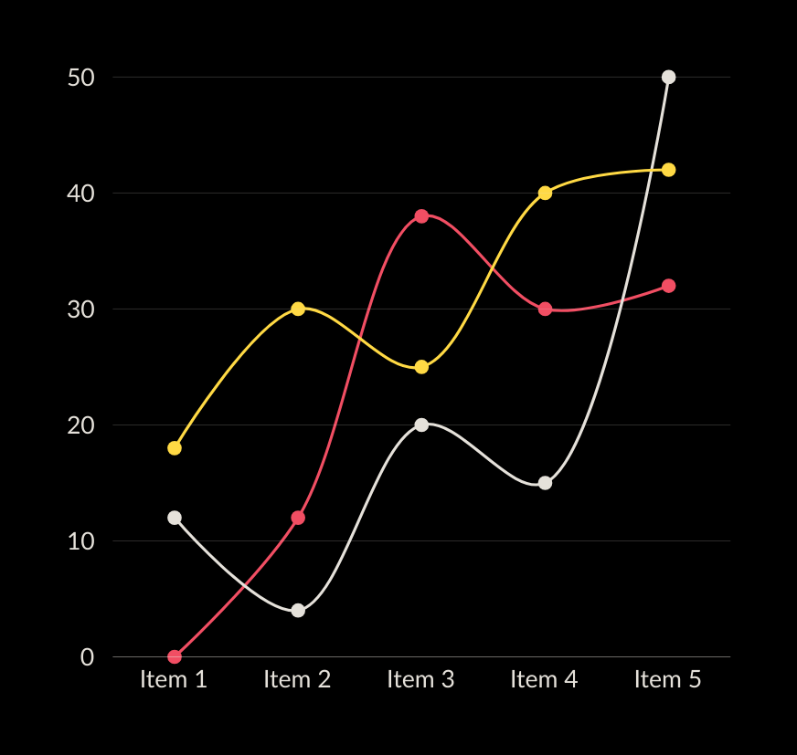
PROJECT TESTING
This matrix provides a snapshot of various success metrics for our company, including revenue growth, customer satisfaction, market share, employee retention, innovation, and brand reputation.
20% annual revenue growth
90% maintain customer satisfaction ratings
15% market share in key segments

Slide 10
DISCUSSION
Our plan for using funds generated from investors is straightforward. We'll allocate 40% towards further developing our products, ensuring they stay competitive and meet customer needs. 30% will go into marketing and sales efforts to attract new customers and drive revenue growth. 20% will be invested in infrastructure and operations to support our expanding business and improve efficiency. Finally, 10% will be set aside for strategic initiatives like market expansion and partnerships to fuel long-term growth.

Slide 11
DISCOVER OUR SERVICES
BRAND BUILDING
DIGITAL MARKETING
We create a strong brand identity, including logos and design elements, to help startups stand out and gain trust.
We develop effective online marketing strategies using channels like social media, email, and ads to reach potential customers.
MARKETING ANALYTICS
PR SUPPORT
We provide insights and reports on marketing performance to help startups make informed decisions.
We help startups get media coverage and build relationships with relevant journalists and influencers.

Slide 12
PROJECT DEMO

Slide 13



Ingoude Company
THANK YOU
for your time and attention
Present by Neil Tran
www.reallygreatsite.com
hello@reallygreatsite.com
123 Anywhere Street., Any City

